Slide 1
Database recovery in Multi Database system

Slide 2
Multi Database Transaction
DBMSs may be relational, whereas others are object-oriented, hierarchical, or network DBMSs.
Each DBMS involved in the multi-database transaction may have its own recovery technique and transaction manager separate from those of the other DBMSs.
To maintain the atomicity of a multi-database transaction, it is necessary to have a two-level recovery mechanism.
A global recovery manager, or coordinator, is needed to maintain information needed for recovery, in addition to the local recovery managers and the information they maintain (log, tables).

Slide 3
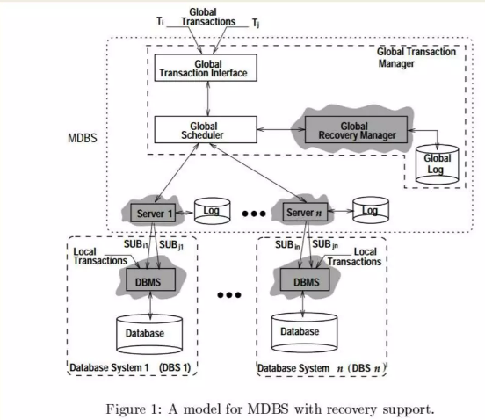
Multi Database System Model

Slide 4
The architecture of MDBS
The architecture of an MDBS basically consists of the Global Transaction Manager (GTM).
A set of Interface Servers (servers, for short), and multiple LDBSs.
To each LDBS, there is an associated server.
An LDBS consists of a DBMS and at least one database.
The GTM comprises three modules:
1. Global Transaction Interface (GTI)
2. Global Scheduler (GS)
3. Global Recovery Manager (GRM).

Slide 5
MDBS Two-level Recovery
To maintain the atomicity of a multi database transaction, it is necessary to have a two-level recovery mechanism.
A global recovery manager, or coordinator, is needed to maintain information needed for recovery, in addition to the local recovery managers and the information they maintain (log, tables).
The coordinator usually follows a protocol called the two-phase commit protocol, whose two phases can be stated as follows:

Slide 6
Phase 1: Voting phase
When all participating databases signal the coordinator that the part of the multi database transaction involving each has concluded.
The coordinator sends a message prepare for commit to each participant to get ready for committing the transaction.
Each participating database receiving that message will force-write all log records and needed information for local recovery to disk and then send a ready to commit or OK signal to the coordinator.
If the force-writing to disk fails or the local transaction cannot commit for some reason, the participating database sends a cannot commit or not OK signal to the coordinator.
If the coordinator does not receive a reply from the database within a certain time out interval, it assumes a not OK response.

Slide 7
Phase 2: Commit phase
If all participating databases reply OK, and the coordinator's vote is also OK, the transaction is successful, and the coordinator sends a commit signal for the transaction to the participating databases.
Because all the local effects of the transaction and information needed for local recovery have been recorded in the logs of the participating databases, recovery from failure is now possible.
Each participating database completes transaction commit by writing a [commit] entry for the transaction in the log and permanently updating the database if needed.
On the other hand, if one or more of the participating databases or the coordinator have a not OK response, the transaction has failed, and the coordinator sends a message to roll back or UNDO the local effect of the transaction to each participating database. This is done by undoing the transaction operations, using the log

